Slide 1
RESUME SERVICES

Slide 2
Definition

Slide 3
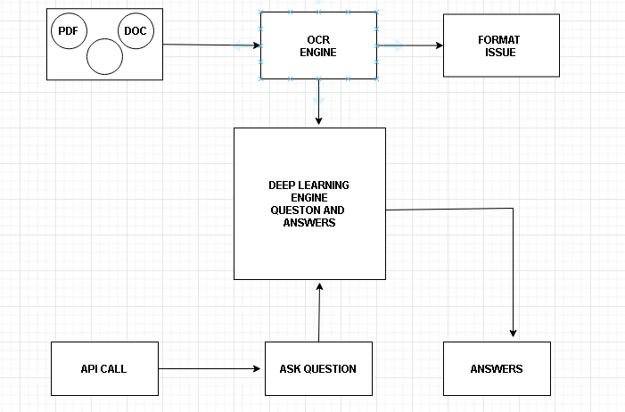

Slide 4
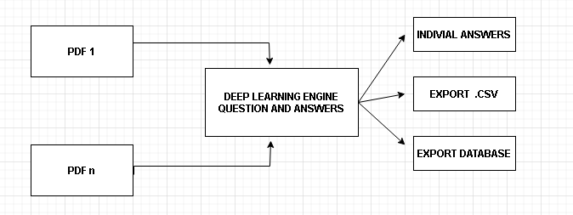

Slide 5
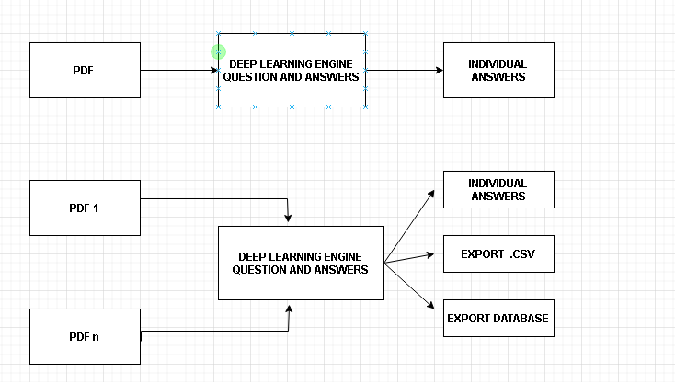

Slide 6
Benefit’s & Automation
Reduce human reading of resume by quasi machine reading
Retrive service automation
Easy categerization and classify

Slide 7
THANK YOU

